Slide 1
Chemistry for Sustainable Energies
Prepared by Dr. Pushpendra rai
Modified by Dr. Druman Utekar

Slide 2
Sustainable Energy
Sustainable energy can be defined as a form of energy that can be utilized again and again without putting a source in danger of getting depleted, expired, or vanished.
Sustainable energy is power which is able to be replenished within a human lifetime and so cause no long-term damage to the environment. Sustainable energy includes all renewable energy sources, such as hydroelectricity, biomass, geothermal, wind, wave, tidal and solar energies.

Slide 3
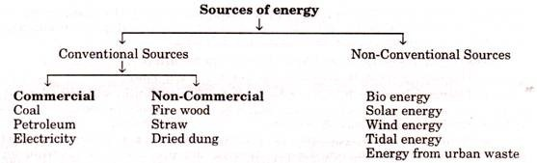
Classification of Energy

Slide 4
Renewable (Non-Conventional) energy: Energy obtained from sources that are essentially inexhaustible such as wind power, solar power, geothermal energy, tidal power and hydro-electric power.
Non-renewable (conventional) energy: Is the conventional fossil fuels such as coal, oil, gas and nuclear energy. This energy is exhaustible.

Slide 5
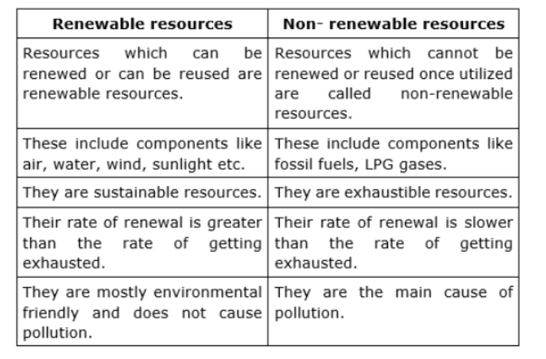
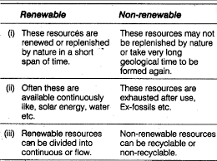



Distinction: Conventional (non-renewable) and nonconventional energy (renewable) sources.

Slide 6


Solar Energy
The electromagnetic radiation from sun is commonly known as solar energy. These radiations are resulted from thermo nuclear fusion reaction on the surface of sun. All the radiation from the sun is not in the same wavelength range. Almost 92% lie in the range of 315 nm to 1400nm.
The estimated amount of solar flux reaching the atmosphere of earth is approximately 1400W/m2min.and that of heat equivalent is 2.68 X 10²⁴ J/Year. The eco system of earth utilizes about 0.2-0.5 % of total amount of solar energy received. It indicates clearly that large amount solar energy get wasted, which otherwise can be immense use for satisfying needs of humans.
Advantage of solar energy:
1. It is non-polluting and non-depleting source of energy.
2. It is renewable source of energy.
3. It is available abundantly.
The solar energy has been successfully used in following purpose
i) Heating: Used for water and space heating in colder countries.
ii) Electricity: Using solar energy electric energy can be generated.
In spite of these advantages, the use of solar energy in large scale is still not in practice, due to
following reasons,
1. Non availability of intense light in all areas throughout year
2. Difficulties faced in economic collection and conversion of solar energy into other forms of
energy such as electricity

Slide 7
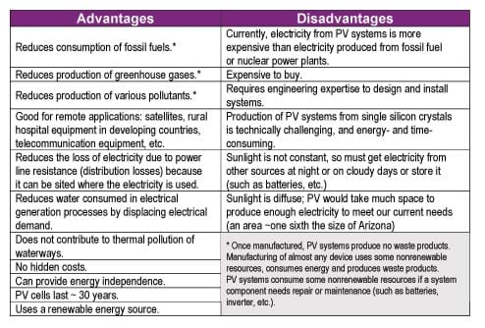


Advantages and Disadvantages

Slide 8


Flat Plate Collector (Solar Heater ):
The device works on the principle of black body in which heat absorbing capacity and tendency of a black surface is utilized to achieve benefits for human.
Construction:
These are the main components of a typical flat-plate solar collector:
Black surface - absorbent of the incident solar energy
Glazing cover - a transparent layer that transmits radiation to the absorber, but prevents radiative
and convective heat loss from the surface
Tubes containing heating fluid to transfer the heat from the collector
Support structure to protect the components and hold them in place
Insulation covering sides and bottom of the collector to reduce heat losses
Application
Some advantages of the flat-plate collectors are that they are:
Easy to manufacture
Low cost, Collect both beam and diffuse radiation
Permanently fixed (no sophisticated positioning or tracking equipment is required)
Little maintenance

Slide 9
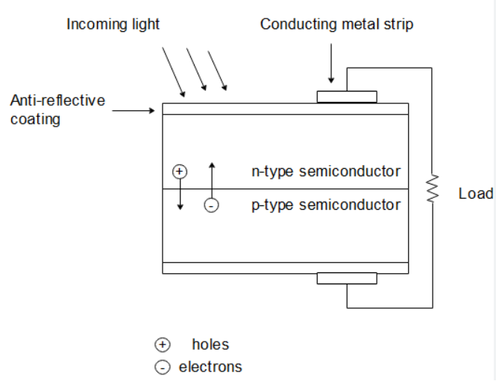




PHOTO VOTAIC CELL (SOLAR CELL)
A photovoltaic (PV) cell, also known as a solar cell, is a device that converts light energy directly into electrical energy through the photovoltaic effect.
Construction: The core component of a PV cell is a semiconductor material, usually silicon. Silicon is doped with elements (usually P or B) to create two distinct layers: an N-type layer (which has an excess of electrons) and a P-type layer (which has an excess of "holes" or positive charge carriers Hence these two layers form p-n junction. A metallic grid is the electrical contact of the diode and allows light to fall on the semiconductor between the grid lines. An anti-reflective layer between the grid lines increases the amount of light transmitted to semiconductor.
Working: When light radiation falls on the p-n junction diode, photons are absorbed and electron-hole pairs are generated. The electrons are diffused and collected at the n-type end and holes are diffused and collected at the p-type end. When these two ends are electrically connected through a conductor, there is a flow of current between the two ends through the external circuit. Thus photoelectric current is produced and available for use. The current output of a cell depends on its efficiency and size and is proportional to the intensity of sun light striking the surface of the cell. Therefore, photovoltaic cells are connected electrically in series or parallel circuits to produce higher voltages, currents and power levels. A number of solar cells electrically connected to each other and mounted in a support structure or frame is called a photovoltaic module. A photovoltaic array is the complete power generating unit, consisting of any number of photovoltaic modules and panels.

Slide 10




Advantages
Renewable Energy Source: Solar energy is abundant and renewable, making PV cells an eco-friendly option for generating electricity without depleting natural resources.
Low Operating Costs: Once installed, PV systems have minimal operating costs as they require little maintenance and can generate electricity for 25-30 years or more.
Silent and Clean Energy Production: PV cells operate silently and produce electricity without emitting greenhouse gases or other pollutants, contributing to a cleaner environment.
Scalability: PV systems come in various sizes and can be installed in different locations (rooftops, ground-mounted arrays, portable systems), making them versatile for residential, commercial, and even off-grid applications. They can be scaled up by adding more panels to meet increasing energy needs.
Energy Independence: Using solar power reduces dependence on fossil fuels and centralized power grids, offering energy independence to individual households or businesses.
Remote Area Power Generation: PV cells can provide electricity in remote or off-grid areas where traditional power infrastructure is unavailable or costly to install.

Slide 11








Limitations
Intermittency and Weather Dependency: Solar power generation is dependent on sunlight availability, making it intermittent. Cloudy weather, nighttime, or shading can significantly reduce electricity output.
Initial Cost: The initial installation cost of PV systems can be relatively high, although prices have been decreasing. The overall return on investment depends on factors like incentives, energy prices, and system efficiency.
Space Requirement: Generating significant power may require considerable space for installing multiple solar panels, especially for large-scale applications.
Energy Storage Challenges: Storing surplus energy generated by PV cells for use during low-light or nighttime hours can be challenging and might require additional equipment like batteries, adding to the overall system cost.
Resource Intensive Production: The manufacturing process of PV cells involves some resource-intensive procedures, including mining and refining of materials, which can have environmental impacts.
Efficiency Variability: The efficiency of PV cells can be affected by factors like temperature, shading, and dust accumulation, leading to variable energy output.

Slide 12
Fuels
Fuels can be defined as substances which undergo combustion in the presence of air to produce a large amount of heat that can be used economically for domestic and industrial purpose.
Examples, Wood, Coal, Kerosene, Petrol

Slide 13





Classification of chemical fuels
Based on the origin: i) Primary or natural fuels
ii) Secondary or artificial or derived fuels
B) Based on Physical State: i) Solid Fuels
ii) Liquid Fuels
iii) Gaseous Fuels
C) Based on Chemical Nature
Organic eg. Vegetable fuel, coal
Inorganic eg. Iron Pyrites
Nuclear Fuels eg. Uranium oxide

Slide 14
Characteristic Properties of Fuels
Fuels are characterized by testing certain physical and chemical properties.
Calorific Value should be as high as possible.
Ignition temperature-Moderate
Flame temperature should be as high as possible.
Flash and Fire point should be as high as possible.
Aniline point should be low.
Cloud and Pour point should be as low as possible.
Viscosity should be adequate.
Coke number should be as high as possible.
Moisture content-as low as possible.
Volatile matter as low as possible.
Ash content should be absent.
Easy risk free transport should be possible.
Storage space-ideally fuel should occupy small space.
Air requirement- adequate
Harmless products should be produced on combustion.

Slide 15

Calorific Value
Calorific value is defined as the number of parts of water which gets heated through 1°C by the heat evolved by the complete combustion of one unit weight of fuel( unit volume of gaseous fuels) under the conditions such as
Whole of heat evolved is absorbed by water.
The products formed leave the system at atmospheric temperature and pressure.
It is the most important property of fuel.

Slide 16
Units of calorific value
B.T.U. (British Thermal Unit)
A British thermal unit may be defined as the heat required to raise the temperature of one pound of water from 60°F to 61°F.
2) K.C.U. (Kilogram Centigrade Unit)
The calorie, a unit of heat may be defined as, the heat required to raise the temperature of one Kg of water from 15°C to 16°C.
Correlation between BTU and KCU:
1BTU = 0.252KCal =252Cal
1KCal = 3.968 BTU
3) C.H.U. (Centigrade Heat Unit)
The calorific value can also be expressed as centigrade heat unit (C.H.U.)., which is the amount of heat required to raise temperature of one pound of water through one degree centigrade.

Slide 17



1) High Calorific value (HCV) or Gross Calorific value (GCV):
High calorific value may be defined as the total amount of heat produced when one unit of the fuel has been burnt completely and the products of combustion have been cooled to 16°C or 60°F.
2) Low calorific value( LCV) or Net Calorific value (NCV)
Low calorific value may be defined as the net heat produced when unit mass or volume of fuel is completely burnt and products are allowed to escape.
NCV or LCV = GCV (HCV) – Latent Heat of water formed
= GCV(HCV) – Mass of hydrogen x 9 x Latent heat of steam
= GCV(HCV) – 0.09 x %H x 587
Because 1 part by weight of hydrogen produces 9 parts (1+8) by mass of water.

Slide 18
Dulong Formula
The calorific value of fuels is determined theoretically by Dulong formula or I.A. Davies formula.
It is expressed as
Q = 1/100 [ 8080 x C + 34500 x (H – O/8) + 2240 x S]
Where, Q = Calorific value in KCU/Kg
C = % of carbon
H = % of hydrogen
O = % of oxygen
S = % of sulphur
Dulong formula for HCV & LCV
HCV = 1/100 [8080 x C + 34500 x (H – O/8) + 2240 x S]
LCV = HCV –[ 9/100 x %H x 587]
Experimentally calorific value of solid and liquid fuel is determined using Bomb Calorimeter.

Slide 19
Numerical 1: A sample of coal contains C = 55%, O = 28%, H =7%, S = 0.7%, N =0.2%, Ash = 0.2%. Calculate the GCV and NCV.
Soln:
GCV = 1/100[ 8080C + 34500(H-O/8) + 2240S]
= 1/100 [ 8080x55 + 34500(7-28/8) + 2240 x 0.7]
= 5667 Kcal/Kg
NCV = HCV – 0.09 x % H x 587
= 5667 – 0.09 x 7 x 587
= 5297.19Kcal/Kg
Numerical 2: A sample of coal has following composition C = 70%, O = 8%, H = 10%, N =3%, S = 2%, Ash = 7%. Calculate HCV and GCV.
Numerical 3: A sample of coal contains C = 61% , O = 32%, S = 0.5%, N = 0.2% and Ash = 0.3%. If NCV of coal is 5313.02KCal/Kg. Calculate % H and GCV.
GCV =1/100[8080C + 34500(H-O/8) + 2240S]----i)
NCV = GCV -0.09x%Hx587
GCV = NCV + 0.09x%H x587-------ii)
1/100[8080C + 34500(H-O/8) + 2240S) = NCV + 0.09x%Hx587

Slide 20
Numerical 3: A sample of coal contains C = 61% , O = 32%, S = 0.5%, N = 0.2% and Ash = 0.3%. If NCV of coal is 5313.02KCal/Kg. Calculate % H and GCV.
GCV =1/100[8080C + 34500(H-O/8) + 2240S]----i)
NCV = GCV -0.09x%Hx587
GCV = NCV + 0.09x%H x587-------ii)
1/100[8080C + 34500(H-O/8) + 2240S) = NCV + 0.09x%Hx587

Slide 21
Numerical 3: A sample of coal contains C = 70% , O = 25%, S = 1%, N = 1% and Ash = 0.5%. If NCV of coal is 5200KCal/Kg. Calculate % H and GCV.
GCV =80.80x70 + 345(H-25/8) + 22.40x1]----i)
=5656+345H-1078.125+22.4
= 4600+345H
NCV = GCV - 0.09x%Hx587
GCV = 5200 + 0.09x%H x587
= 5200 + 52.83H-------ii)
4600.275+345H = 5200 + 52.83H
345H- 52.83H = 5200-4600.275
292.17H = 599.725
H = 2.05%
GCV= 5308.44Kcal/Kg

Slide 22

l Hydrocarbon as Fuel
Hydrocarbons are organic compounds composed primarily of hydrogen and carbon atoms. Hydrocarbons are the primary constituents of fossil fuels, which have been the backbone of modern civilization's energy consumption for decades. They power vehicles, aircraft, ships, and provide heating and electricity for residential, commercial, and industrial purposes.
Characteristics of Hydrocarbons as Fuel:
Energy-Dense: Hydrocarbons are highly energy-dense compounds, making them efficient sources of fuel. When burned, they release significant amounts of energy, which can be harnessed for various purposes like transportation, electricity generation, heating, and industrial processes.
Various Forms: Hydrocarbons exist in different forms, including solid (like coal), liquid (such as crude oil and its derivatives like gasoline, diesel, and kerosene), and gaseous (like natural gas). This diversity allows for flexibility in their applications.
Ease of Transport and Storage: Liquid hydrocarbons, such as gasoline and diesel, are relatively easy to transport and store compared to other forms of energy. They have high energy density per unit volume, allowing for convenient storage and transportation via pipelines, tankers, and fuel storage facilities.

Slide 23




Environmental and Societal Impact:
The biggest challenge modern industrial society is facing today is the decline and exhaustion of the fossil energy resources. The primary sources of energy that power our civilization are those fossil fuels.
The combustion of hydrocarbons releases carbon dioxide (CO2), a greenhouse gas contributing to climate change. Additionally, incomplete combustion can result in emissions of harmful pollutants like carbon monoxide (CO), nitrogen oxides (NOx), and particulate matter, which contribute to air pollution and health issues.
Therefore continued use of hydrocarbon derived from fossils-sourced fuels is now widely recognized as unsustainable because of depleting supplies and increasing demand.

Slide 24

Future Trends and Alternatives:
Shift Towards Renewable Energy: Increasing concerns about climate change and environmental impact are driving efforts to transition away from fossil fuels. Renewables like power alcohol and biodiesel, fuel cell are gaining prominence due to their lower environmental impact and potential for sustainable energy generation.
Technological Innovations: Ongoing research and development aim to improve the efficiency of hydrocarbon-based fuel production and reduce their environmental footprint.

Slide 25
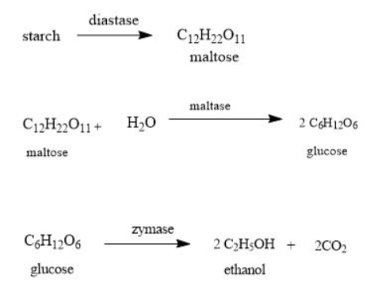


Power alcohol
Power alcohol, also known as ethanol or ethyl alcohol, is a type of renewable biofuel derived from plant materials such as sugarcane, corn, barley, wheat, or cellulose-rich materials like wood chips and agricultural residues.
Production:
Fermentation: Power alcohol is primarily produced through a process called fermentation, where sugars present in plant materials are converted into ethanol by the action of yeast or bacteria in the absence of oxygen.

Slide 26



Advantages
Reduced Greenhouse Gas Emissions: When compared to fossil fuels, ethanol generally produces lower net carbon dioxide emissions, contributing to mitigating climate change.
Domestic Production: Many countries aim to promote ethanol production from locally grown crops, reducing dependence on imported oil and enhancing energy security.
Fuel Properties: Ethanol has high octane ratings and can be used as a blending component in gasoline to enhance its octane level and reduce emissions.
Renewable and Environmentally Friendly: Power alcohol is considered a renewable fuel as it is derived from plant matter that can be grown and harvested repeatedly. It is also relatively cleaner burning compared to fossil fuels, emitting fewer greenhouse gases and pollutants like carbon monoxide and particulate matter.

Slide 27





Limitations
Lower Energy Density: Ethanol has a lower energy density ( calorific value 7000 Kcal/Kg as compared to gasoline ( 12000 Kcal /Kg), resulting in decreased fuel efficiency when used as a standalone fuel. Vehicles running on ethanol may experience reduced mileage compared to gasoline-powered vehicles.
Cold Weather Performance: Ethanol has a higher water content, making it prone to issues in cold weather conditions, such as difficulties in starting engines and potential corrosion of fuel system components.
Infrastructure and Compatibility Issues: While some vehicles are designed to run on ethanol (flex-fuel vehicles), the widespread use of ethanol as a fuel requires significant changes in infrastructure, including fuel distribution systems and vehicle engines, which might not be readily available or cost-effective.
It must be noted that these disadvantages are significantly reduced when biodiesel is used in blends with petrol.

Slide 28
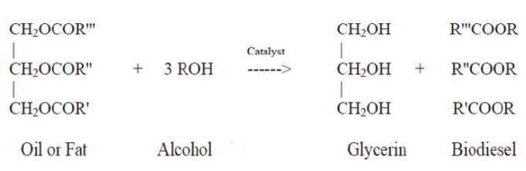

Biodiesel
Biodiesel is a liquid biofuel obtained by chemical processes from vegetable oils or animal fats and an alcohol that can be used in diesel engines, alone or blended with diesel oil
Biodiesel is an alternative energy source and could be a substitute for petroleum-based diesel fuel.
The production of biodiesel chemical reaction is known as transesterification.
Transesterification is the chemical process, which converts natural fats and oils into Biodiesel. Most of the biodiesel is produced from waste animal fats and vegetable oils obtained from restaurants, and industrial food producers.

Slide 29


Advantages of the Use of Biodiesel:
Some of the advantages of using biodiesel as a replacement for diesel fuel are Renewable fuel, obtained from vegetable oils or animal fats.
Low toxicity, in comparison with diesel fuel. ✓ Degrades more rapidly than diesel fuel, minimizing the environmental consequences of biofuel spills.
Lower emissions of contaminants: carbon monoxide, particulate matter, polycyclic aromatic hydrocarbons, aldehydes.
Lower health risk, due to reduced emissions of carcinogenic substances. ✓ No sulfur dioxide (SO2) emissions.
Higher flash point (100C minimum).
May be blended with diesel fuel at any proportion; both fuels may be mixed during the fuel supply to vehicles.
Excellent properties as a lubricant.
It is the only alternative fuel that can be used in a conventional diesel engine, without modifications.

Slide 30

Disadvantages of the Use of Biodiesel
Slightly higher fuel consumption due to the lower calorific value of biodiesel.
Slightly higher nitrous oxide (NOx) emissions than diesel fuel.
Higher freezing point than diesel fuel. This may be inconvenient in cold climates.
It is less stable than diesel fuel, and therefore long-term storage (more than six months) of biodiesel is not recommended.
It may degrade plastic and natural rubber gaskets and hoses when used in pure form, in which case replacement with Teflon components is recommended.
In consequence, the cleaning of tanks prior to filling with biodiesel is recommended.
It must be noted that these disadvantages are significantly reduced when biodiesel is used in blends with diesel fuel.

Slide 31
Rechargeable Batteries

Slide 32
INTRODUCTION
Battery: It is a device consisting of two or more galvanic cells connected in series or parallel or both
Classification of batteries:
1. Primary batteries: In these batteries the cell reaction is not reversible, after discharging cannot be rechargeable.
Ex. Zn-MnO2 dry cell.
2. Secondary batteries: In these battery the cell reaction is completely reversible, after discharging can easily rechargeable.
Ex. Lead-acid battery, Ni-Cd battery.

Slide 33
lead–acid battery
nickel–cadimium battery
Types Of Secondary Batteries
lithium-ion battery

Slide 34
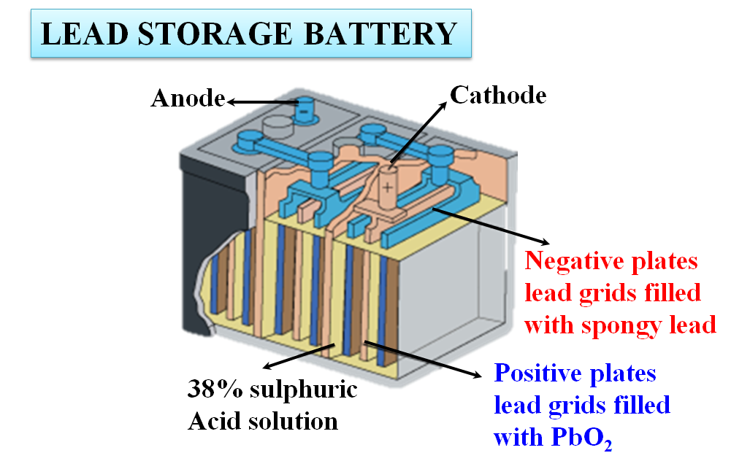



Lead acid Batteries

Slide 35
The Lead-acid battery is one of the oldest types of rechargeable batteries. These batteries were invented in the year 1859
Lead-acid batteries can be classified as secondary batteries. The chemical process of extracting current from a secondary battery (forward reaction) is called discharging. The method of regenerating active material is called charging.

Slide 36


Construction:
Cathode: Group of lead plate bearing spongy lead
Anode: a grid of lead bearing lead oxide
Electrolyte: in lead acid battery dilute sulphuric acid (38%) is used as an electrolyte.
Separator: It is most important part of lead acid battery. Which separate the positive and negative plates from each other and prevents the short circuit. The material used for separators are wood, rubber, glass wood mate, pvc.

Slide 37
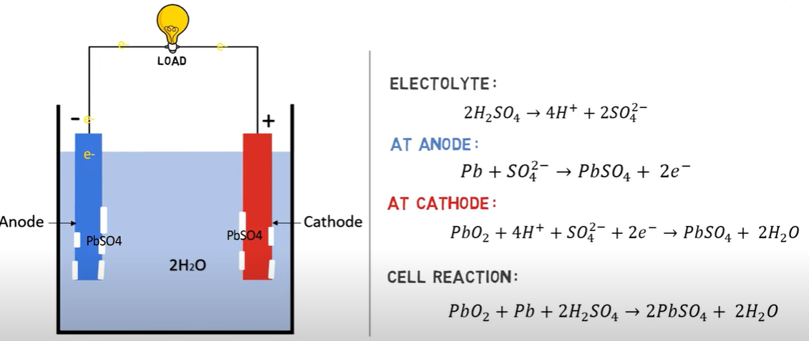
Reaction (During Dischharging):

Slide 38
Life
The optimum functional temperature for lead acid battery is 25⁰C which means 77⁰F. The increase in the range of temperature shortens longevity. A per the rule, for every 80oC increase in temperature, it reduces the half-life of the battery. While a value regulated battery that functions at 25⁰C has a lead acid battery life of 10 years. And when this is operated at 33⁰C, it has a life period of 5 years only.
Lead Acid Battery Applications
These are employed in emergency lightening to provide power for sump pumps.
Used in electric motors
Submarines
Nuclear submarines

Slide 39
INTRODUCTION
2. NICKEL-CADMIUM BATTERY
The nickel-cadmium battery, often known as the ‘NiCad’ battery, is a rechargeable battery that uses metallic cadmium along with nickel oxide hydroxide as the cell’s electrodes.
Nickel(hydroxide)–cadmium systems are the most common small rechargeable battery type for portable appliances. The sealed cells are equipped with “jelly roll” electrodes, which allow high current to be delivered in an efficient way. These batteries are capable of delivering exceptionally high currents, can be rapidly recharged hundreds of times, and are tolerant of abuse such as over discharging or overcharging.
It produces a voltage of about 1.4 V

Slide 40
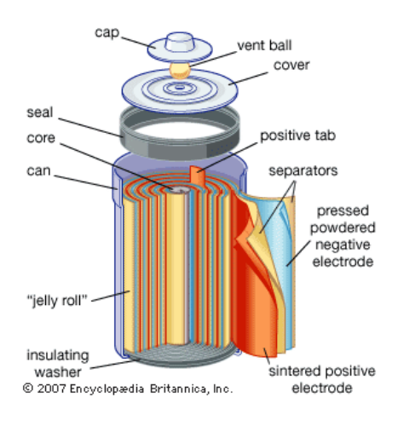


Construction:
The nickel-cadmium battery is constructed similarly to lead-acid batteries. It is made up of three basic layers. The nickel layer is first, followed by the separator layer, and then the cadmium layer. The nickel layer functions as a positive electrode collector, while the cadmium layer functions as a negative electrode collector.
KOH or NaOH is used as a separator layer between the two layers. Its role is to supply OH ions. A safety valve, sealing pad, insulation ring, insulation gasket, and an exterior case round out the package. The insulator ring's job is to keep the two layers apart by providing insulation

Slide 41

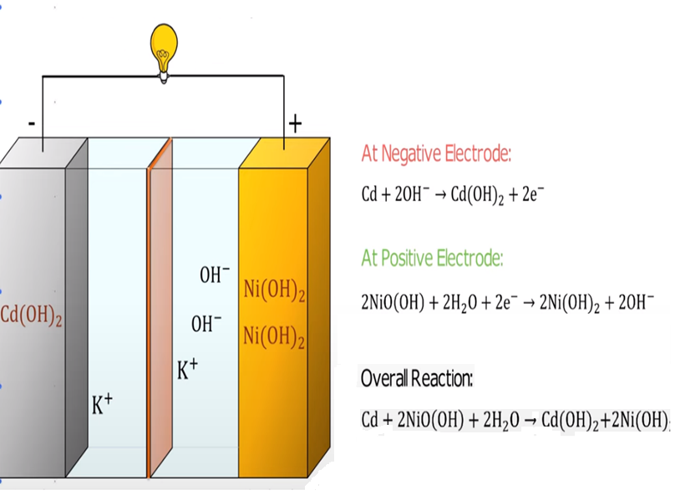
Cell Reaction during discharging:

Slide 42

ADVANTAGES
Fast and simple charging process
It is compact and lighter than traditional batteries
It has a longer life than lead storage batteries
Available in a wide range of sizes and performance options
Good low-temperature performance
Only battery that can be ultra-fast charged with little stress

Slide 43
LIMITATIONS
It is rather more expensive than a lead storage battery
It has a lower energy density value
Cadmium is a toxic metal. Cannot be disposed of in landfills
Memory effect; needs periodic full discharges
High self-discharge; needs recharging after storage

Slide 44

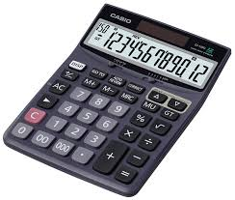



APPLICATIONS
Ni-Cd cells are popularly used in many appliances because they are available in variety of sizes and capaciities.
Few examples are:
Calculators
Electronic flash units
Transistors
Cordless appliances

Slide 45
3. RECHARGEABLE LITHIUM Batteries

Slide 46





DESCRIPTION
Lithium ion battery is a type of rechargeable battery that uses lithium based compound as active raw material. Since lithium is very reactive compound it can not be used in pure form hence we use lithium based compound as cathode material.
Anode: Some batteries use pure graphite as cathode while some uses lithium hexa carbide (LiC6)
Cathode: It is an intercalated compound of Lithium metal oxide (LiMO2) where metal can be like Cobalt, Manganese, Titanium
Electrolyte: It contains lithium hexa fluoro phosphate (LiPF6)
Separator: A non conductive polymer material is used as separator

Slide 47
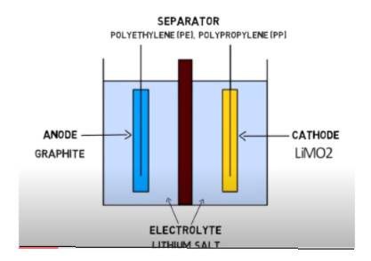

During the charging and discharging process, the lithium ions move back and forth between the two electrodes of the battery, which is why the working principle of a lithium-ion battery is called the rocking chair principle.

Slide 48


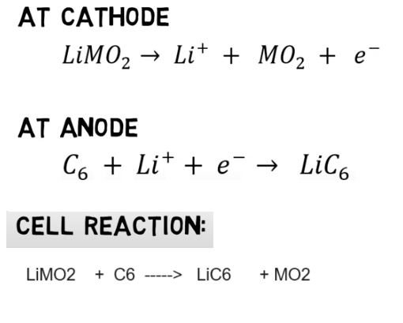

Slide 49

Advantages
1. Lithium-ion batteries have a significantly low self-discharge rate as compared to the other type of batteries.
2. They have a high energy density.
3. There exists no memory effect in lithium-ion batteries.
4. The average life span of lithium-ion batteries is ten times more than the traditional lead-acid batteries.
5. The charging rate of lithium-ion batteries is high.
6. Lithium-ion batteries work efficiently under extreme conditions such as high pressure and temperature fluctuations.
7. Lithium-ion batteries are lightweight and compact in size. Typically, the weight of lithium-ion batteries is roughly 50-60% less than the standard lead-acid batteries.
8. Installation of lithium-ion batteries is comparatively easy.

Slide 50

Applications
Emergency Power Backup Or UPS
Dependable Electric And Recreational Vehicle Power
Solar Power Storage
Reliable And Lightweight Marine Performance
Solar Power Storage
Surveillance Or Alarm Systems In Remote Locations
Personal Freedom With Mobility Equipment
Portable Power Packs That Eliminate Downtime

